Slide 1
Literature Review ZHU Cai AMA

Slide 2
Contents
1
Introduction to mGARCH
2
Paper-Searching by Journals
3
Paper -Searching by Authors
4
Results of Elementary Analysis
5
Suggestions

Slide 3
Paper Searching(08-10) - Journal of Econometrics (A)
Sequential conditional correlations: Inference and evaluation
Volume 153, Issue 2, Dec. 2009, Pages 105-210
This paper presents a new approach to the modeling of conditional correlation matrices within the multivariate GARCH framework. The procedure, which consists of breaking the matrix into the product of a sequence of matrices with desirable characteristics, in effect converts a highly dimensional and intractable optimization problem into a series of simple and feasible estimations.
69 selected stocks from the NASDAQ10
Copula-based multivariate GARCH model with uncorrelated dependent errors
Volume 150, Issue 2, Jun. 2009, Pages 207-218
Model MGARCH for non-normal multivariate distributions using copulas. Multivariate GARCH (MGARCH) models are usually estimated under multivariate normality. For non-elliptically distributed financial returns, the dependence structure is controlled by a copula function.

Slide 4
Paper Searching – Real Estate Economics (A)
Modeling Long Memory in REITs
Volume 36 Issue 3, Pages 533 - 554, Jul.2008
Assessing the Forecasting Performance of Regime-Switching, ARIMA
and GARCH Models of House Prices
Volume 31, Issue 2, Pages: 223-243, Jun. 2003
compares the forecasting performance of three types of univariate time
series models: ARIMA, GARCH and regime-switching

Slide 5
Paper Searching – Journal of Real Estate Finance and Economics (A)
A Comparison of Alternative Forecast Models of REIT Volatility
31 July 2009, DOI: 10.1007/s11146-009-9198-7
compares the relative performance of ARFIMA, FIGARCH, EGARCH and
FIEGARCH, and make the conclusion that long-memory models should
also be adopted to forecast REIT volatility, univariate GARCH models
Are Securitized Real Estate Returns more Predictable than Stock Returns?
16 Nov 2008, DOI: 10.1007/s11146-008-9162-y
forcasting, ARMA–EGARCH, EGARCH
Monetary Shocks and REIT Returns
27 July 2007, DOI: 10.1007/s11146-007-9038-6
univariate GARCH model with dummy variable
Multivariate Modeling of Daily REIT Volatility
28 Mar 2006, DOI: 10.1007/s11146-006-6804-9
Multivariate VAR–GARCH (BEKK)

Slide 6
Paper Searching – Journal of Real Estate Finance and Economics (A)
Volatilities and Momentum Returns in Real Estate Investment Trusts
20 Feb 2009, DOI: 10.1007/s11146-008-9165-8
GARCH-in-mean, liquidity risk in mean, univariate GARCH
Price Discovery in Real Estate Markets: A Dynamic Analysis
1 April 2009, DOI: 10.1007/s11146-009-9172-4
Conditional Volatility of Equity Real Estate Investment Trust Returns: A Pre-
and Post-1993 Comparison
15 August 2007 DOI: 10.1007/s11146-007-9079-x

Slide 7
Paper Searching – Journal of Property Investment and Finance (B)
REITs Design and Future REITs Market in China (2009), Value at Risk(2008)
REITs, the stock market and economic activity
Volume 27, Issue 6, 2009
Investigate the linkages among REITs, the stock
market, and real economic activity, VAR, Grange Causal Test
Correlation structure of real estate markets over time
Volume 27, Issue 6, 2009
time-varying correlation structure, portfolio management, REITs,
window rolling, Markowitz' portfolio theory
Time-varying performance of four Asia-Pacific REITs
Volume 26, Issue 3, 2008
determine the dynamic relationships between REIT returns, multi-factor model
Regime switching and asset allocation: Evidence from international real estate security markets
Volume 25, Issue 3, 2007
Regime switch model, CAPM
Cross-market dynamics in property stock markets
Volume 23, Issue 1, 2005
Multi-EGARCH, Cointegration

Slide 8
Paper Searching – Property Research (B)
Financial Crisis and Asian Real Estate Securities Market Interdependence:
Some Additional Evidence
Volume 25, Issue 2, 2008
linear cointegration, nonlinear cointegration, Granger causality, Valatility spillover
Modelling Linkages between US and Asia-Pacific Securitized Property Markets
Volume 24, Issue 2 June 2007
Cointegration, Granger causality, variance decomposition analysis
The Dynamics of Return Volatilty and Systematic Risk in International Real Estate
Security Markets
Volume 24, Issue 1 March 2007
ARMA (1, 1) - GJR - GARCH (1, 1) - M

Slide 9
Property Management (B) Paper Searching –Journal of real estate literature (B) Journal of real estate research (B)
The asymmetric volatility of house prices in the UK
Volume 27, Issue 2, 2009
GJR-GARCH
De-lagging Hong Kong's office price indices via State Space Model with
Kalman filter
Volume 26, Issue 2, 2008

Slide 10
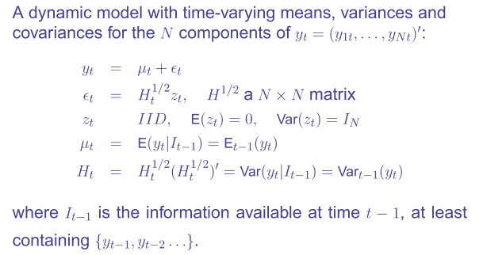
Multivariate GARCH Model- Definition

Slide 11
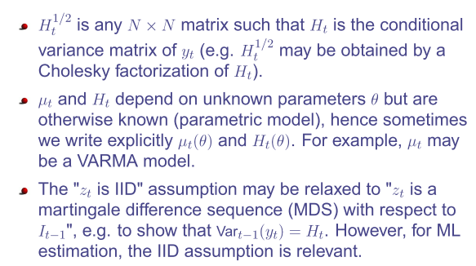
Multivariate GARCH Model- Definition

Slide 12
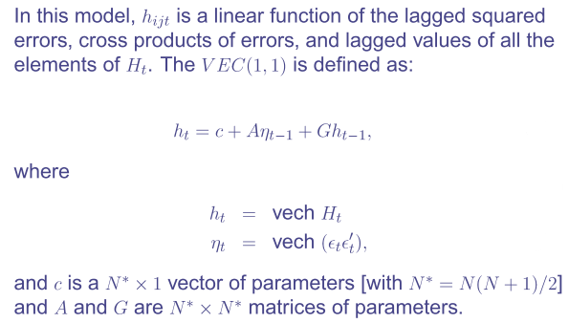
VEC(1,1) ( Bollerslev, Engle, and Wooldridge, 1988 )

Slide 13
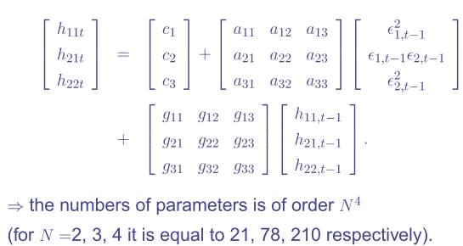
Bivariate VEC(1,1)

Slide 14
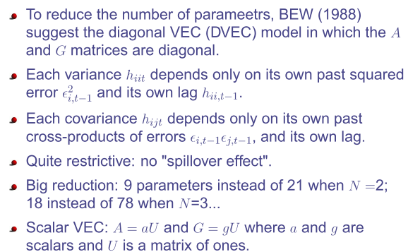
Diagonal and Scalar VEC

Slide 15
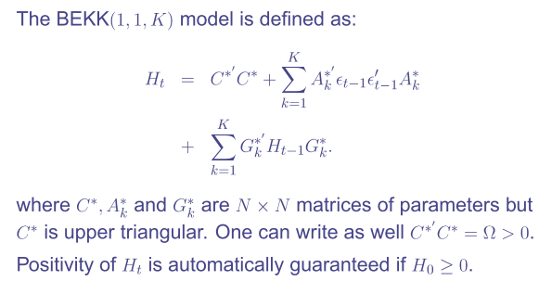
BEKK(1,1,K) ( Engle and Kroner, 1995)

Slide 16
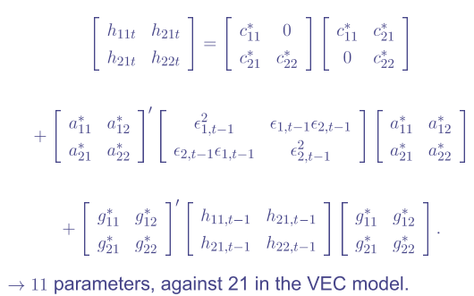
Bivariate BEKK(1,1,1)

Slide 17
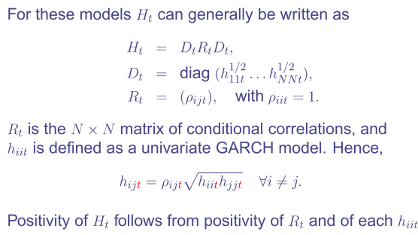
Conditional Correlations

Slide 18
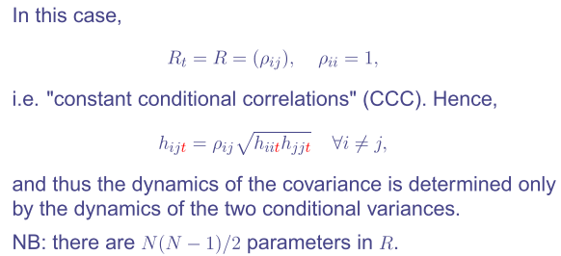
CCC (Bollerslev, 1990)

Slide 19
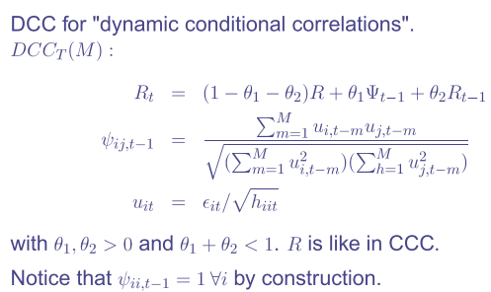
DCC of Tse & Tsui (2002)

Slide 20
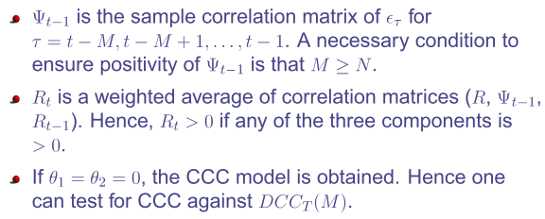
DCC of Tse & Tsui (2002)

Slide 21
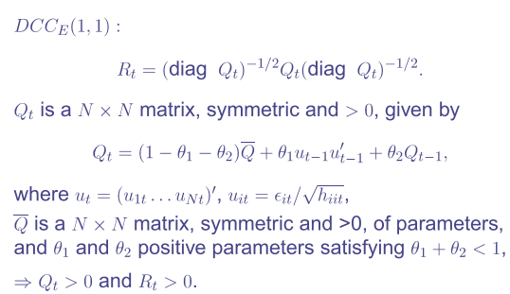
DCC of Engle (2002)

Slide 22
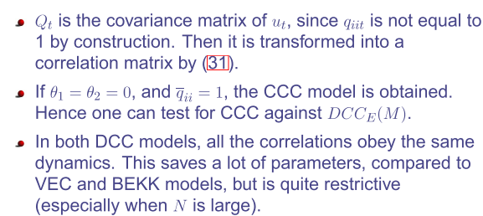
DCC of Engle (2002)

Slide 23
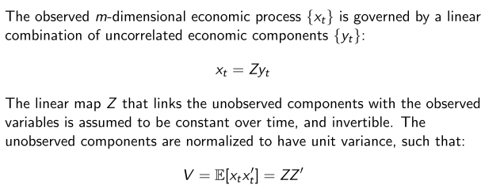
GO-GARCH Van Der Weide (2002)

Slide 24
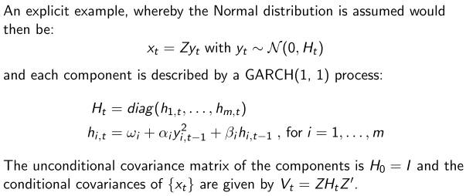
GO-GARCH Van Der Weide (2002)

Slide 25
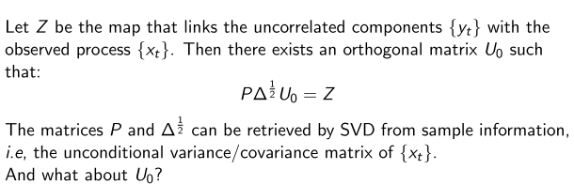
GO-GARCH Van Der Weide (2002)

Slide 26
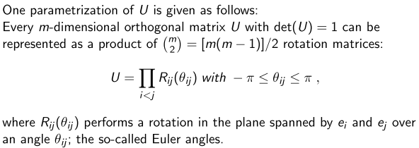
GO-GARCH Van Der Weide (2002)

Slide 34
Thank You !
Add your company slogan

